Slide 1
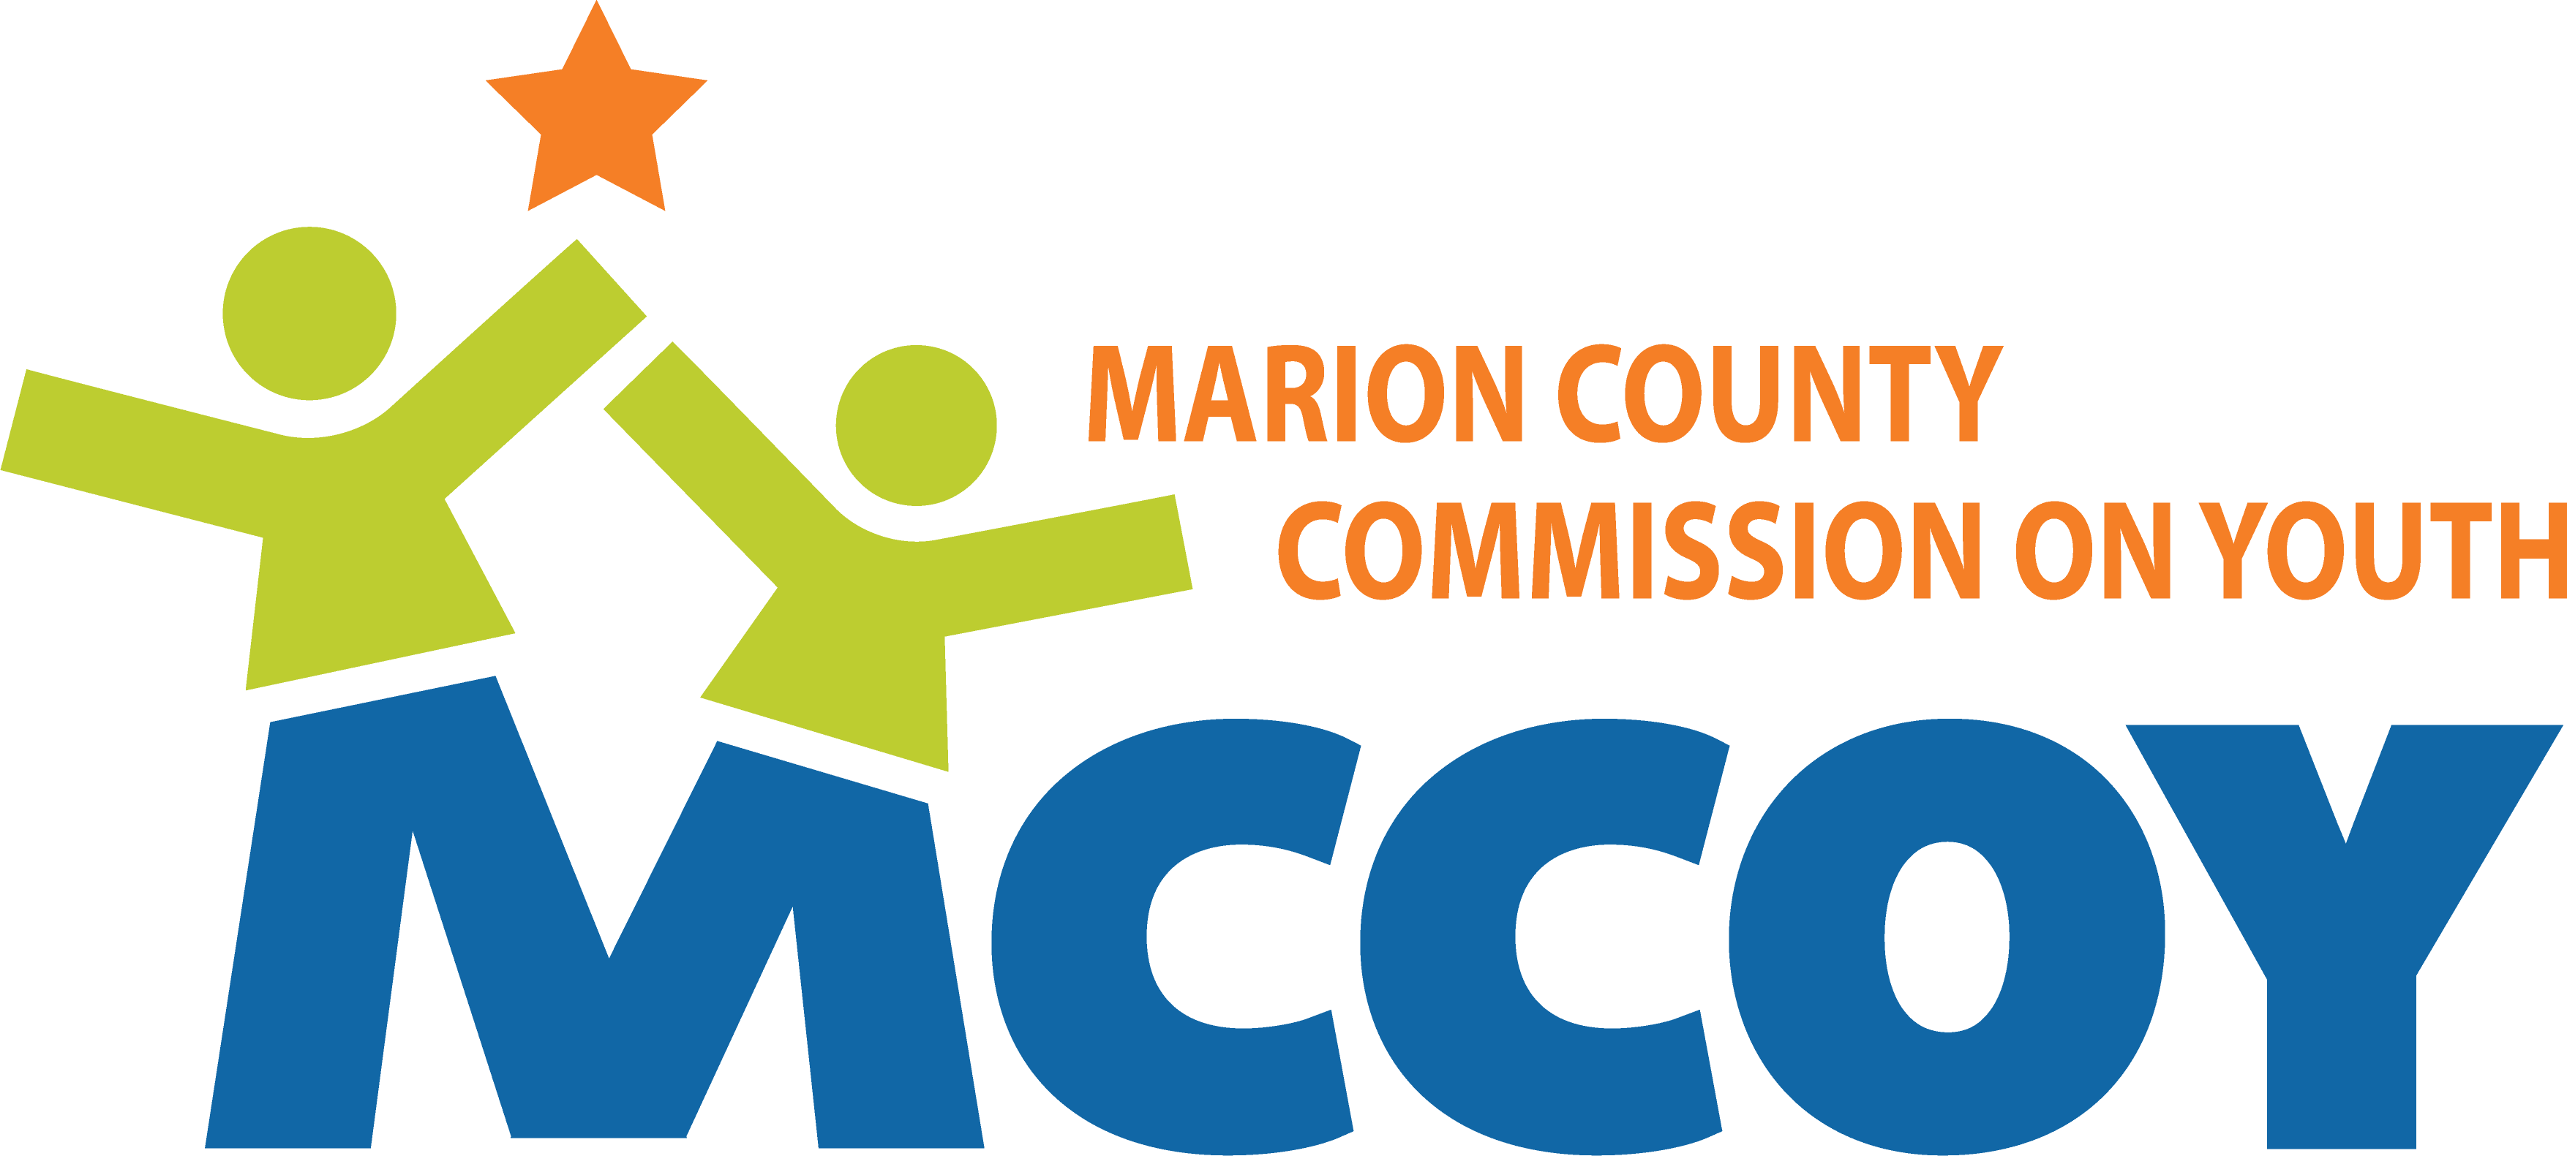
Board of Directors Dashboard
1. Mission and Systems Impact – are we strengthening the youth ecosystem in Marion County?
Systems Coordination
10 cross-sector convenings (YTD)
Action items advanced:
  Initiating assessment of youth-worker wellbeing
Youth Indicators (annual trend)
Mental Wellness indicator
Youth violence indicator
Other?
Youth Worker Indicators (annual trend)
Mental Wellness indicator
Capacity indicator
2. Program Performance – are flagship initiatives delivering and scaling with quality?
Summer Youth Program
286 Programs supported – first newsletter March 1
# Youth workers trained – May start
Resilience Project
Schools participating: 5
Educators trained: 0 YTD
Students engaged: 0 YTD
% increase in key indicators
Status of expansion:
  Adding follow on modules
  Pike – adding schools 2/3; adding 4th in Guion Elem.
  Warren – adding more 6th grade teachers
Advocacy
5-8 Policy actions influenced
Y D@SH participation – 353; 25 Resource Fair participants; 9 legislators
Learning Network
5 Trainings delivered
136 Participants
Repeat participation rate – n/a to date
Badges earned – Summer launch
Youth Voice
7 youth convenings YTD (MYLC, JAC, Fever Confidence)
Key actions:
3. Financial Health & Sustainability
Financial Position – annual view
8 month of operating reserves
Unrestricted 24.5% of total grants
Revenue concentration -- 56% top 3 funders
Fund Development Progress
Total revenue YTD vs budget
# New funding sources added
Expense Management
Actual v. budget %
Major variance explained:
4. Visibility, Influence, & Reputation – are we seen as Marion County’s youth backbone?
7 Media mentions; significant non-media mentions in social channels
Social Media: 296 reactions; 1148 views; 9545 post impressions; 38 shares and engagement rate up 7.6%
Brand awareness metric – tbd
Thought leadership pieces published
On Track
Watch
Off Track

