Slide 1

Championing the positive development of youth in Central Indiana
Finance Committee Presentation

Slide 2

2025 Financials
Financial Statement Notes
Net Income through September finished favorable to budget by $551K
Grant income favorability due primarily to the to renovation grant (not inclued in budget) from Indy Sports Corp.
Program expenses have largely been spent for the fiscal year, and expected to finish close to budget by the end of the year

Slide 3
2025 Financials
Key Terms
Accounts Receivable – Invoices MCCOY has sent and awaiting payment
Deferred Revenue – Represents cash received from specific grants where MCCOY has yet to fulfill the obligation
ROU Asset/Lease Liability – Accounting concept reflecting value of current lease. Nets to $0 on statements
Notes to the Financials
Deferred Revenue balance consists primarily of unused awards from Lilly Endowment and United Way
The current AR balance has increased due to recent invoicing, but expected to be settled by the end of October
Increase in Fixed Assets are primarily related to the office remodel

Slide 4
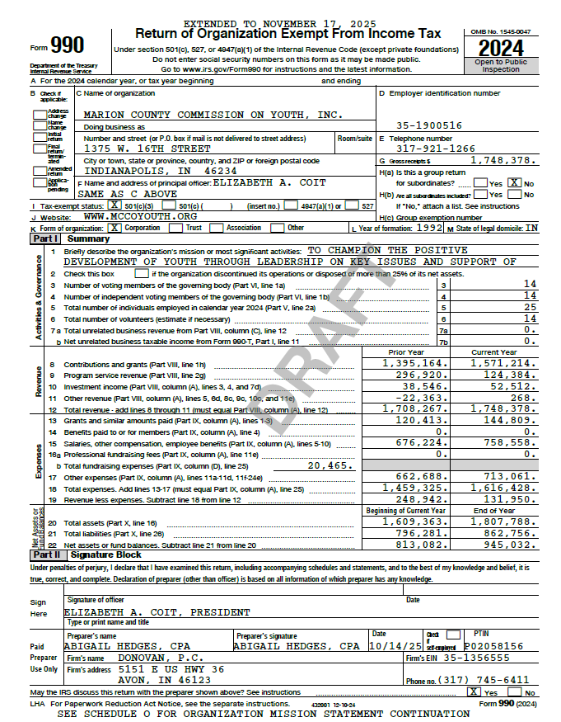
2024 Form 990 – Federal Tax Return
2024 Form 990
Finance Committee recommends to the board that the 2024 Form 990 be accepted
Complete return available on the Board of Directors portal.

