Slide 1

Board Update
February 26, 2025

Slide 2
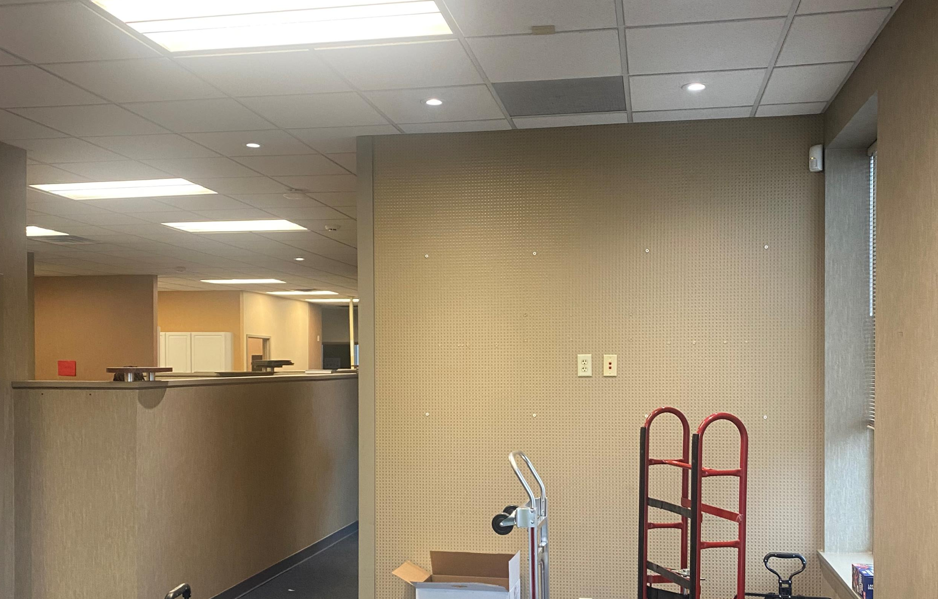
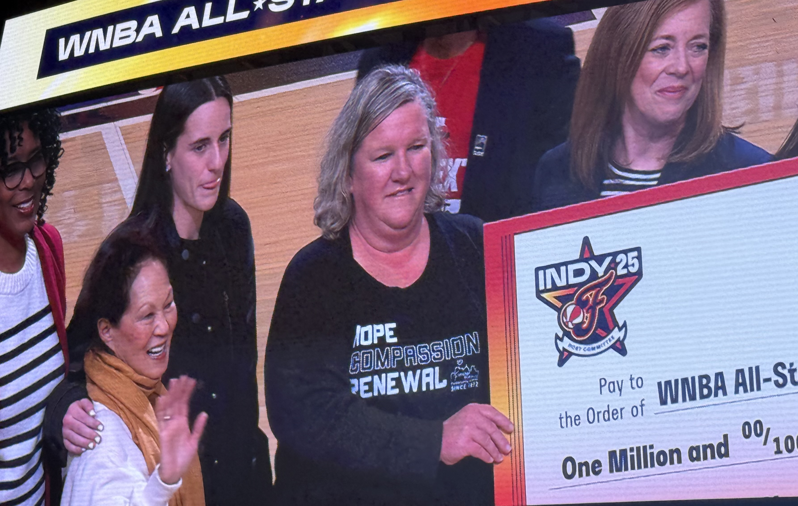
Operations Update
Office renovations
  Moved out as of February 14; renovations began February 15
  “Big Check” presentation at halftime of February 18 Pacer’s game – good press coverage
  Meeting with contractor and architect team bi-weekly onsite – a few changes have already been made
Operations
  Annual Audit – Prelim review with my team in April; Report to finance committee in June
  New performance review platform in development for 2Q rollout

Slide 3
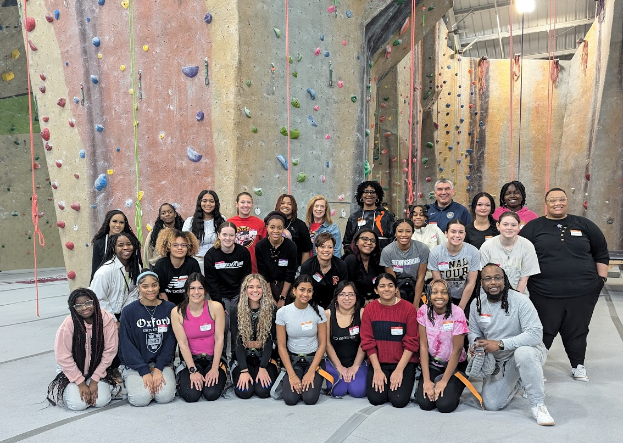
HIGHLIGHTS
New Programs
Juvenile Advisory Council
Working group established
Working towards late spring JAC initial gathering
Post-pilot (Indy Foundation) funding grant submitted
All Star Ambassador program
25 HS women from across the city (and beyond)
Tip Off in January; meet monthly (plus extra); culminates at All Star game in July
rant submitted
The Resilience Project
Teacher SEL curriculum and student emotions temperature check tool in development
Post-spring break launch
Warren (tbd) and Pike (6th grade) townships

Slide 4

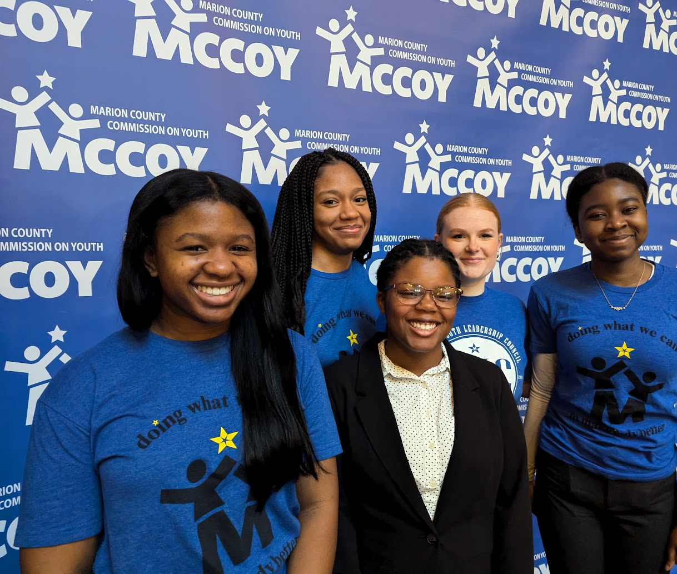
Highlights
Ongoing Programs
Early Intervention Planning Council – release of the Where the Children Are report in March; full roll out plan includes community conversations; “dog and pony” presentations
2025 Summer Youth Program
Partnering with IAN to offer more accessible organizational assessment tool
Adding Spanish language Boot Camp
Adding Directors training and networking
MYLC & Impact Team- ongoing program going well

Slide 5
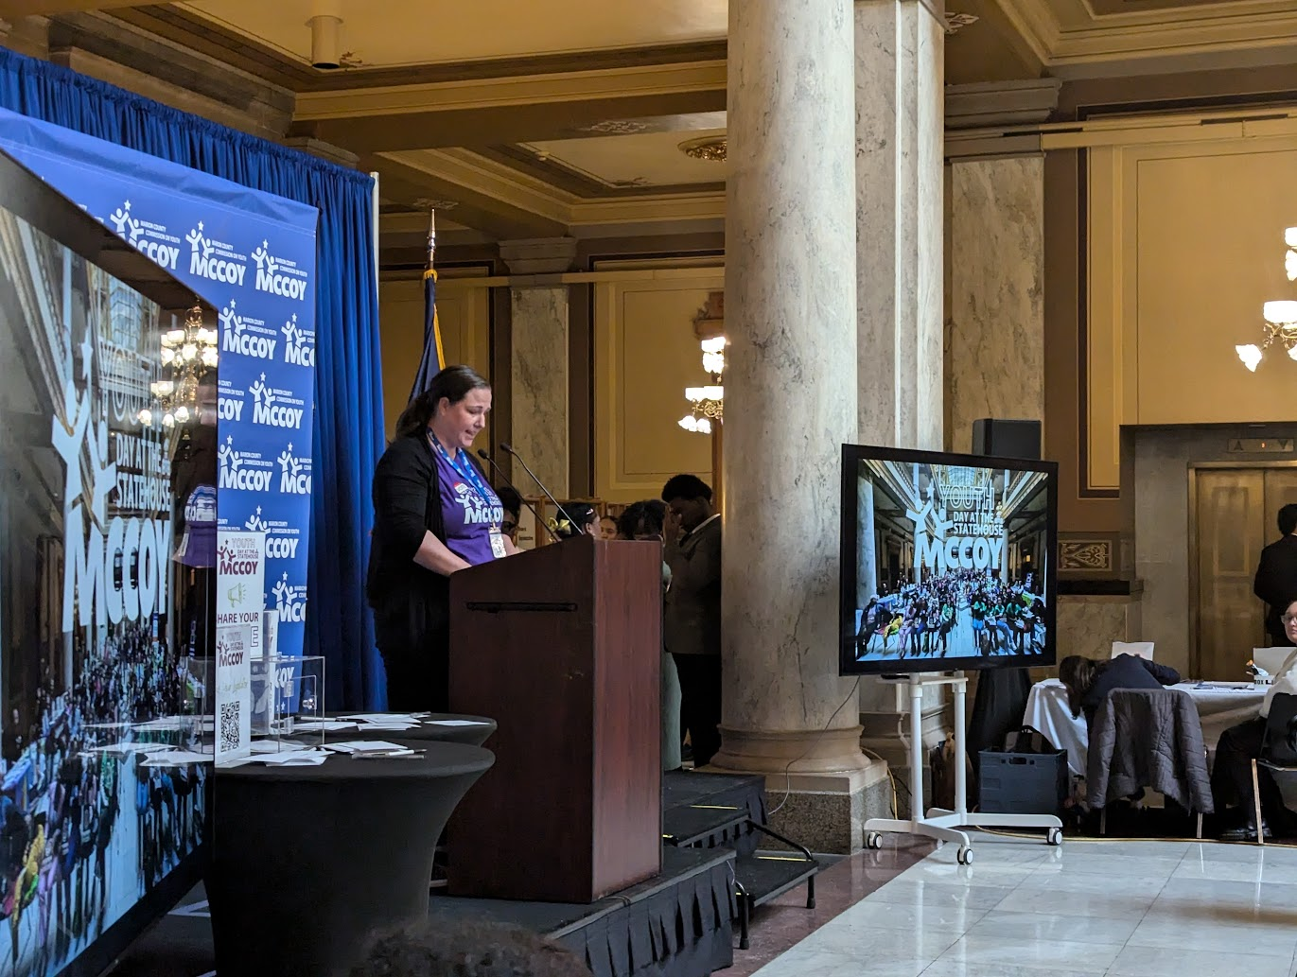
Highlights
Ongoing Programs
  Learning Network – active; increased requests for organization specific DEIB training
  Advocacy
  Youth Day @ the Statehouse – 350 attended (down from 2024 although registration was up); good media coverage
  Mid-way through session; gearing up to testify where needed

Slide 6
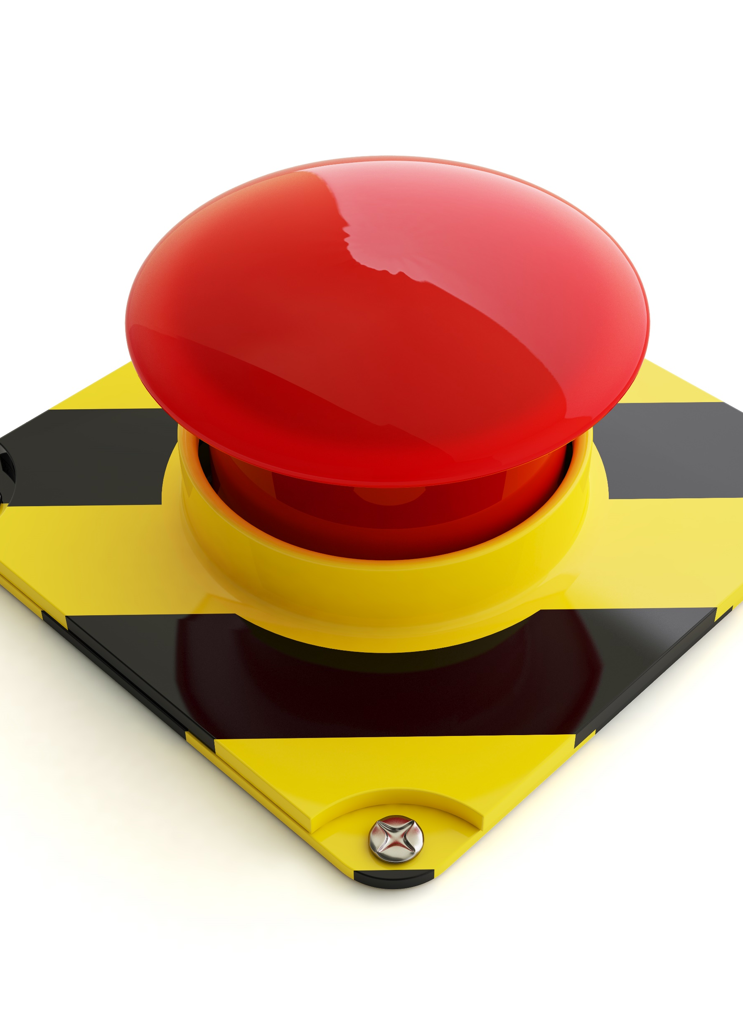
Challenges
  Impacted programs
  Youth Working for Indy – funds 90+ youth workers in SYPF programs
    City of Indy/CDBG = $37,500 (of $157,500 program) in question
Youth Worker Well-being Project –
  Two programs under review given state funding risks for 4 of 5 intermediaries (ELOC; DEIB grants)
Cancelled program
  CDC/NACCHO funded Violence Prevention Action Team with City of Indy has been put on hold by the CDC (MCCOY is the fiscal sponsor)

