Slide 1

President’s Report - HIghlights
Board Meeting
April 30, 2025

Slide 2

Mission Moment
https://photos.app.goo.gl/717cuUut8x72gt7F9

Slide 3
Mark your calendars – you’re invited!
MYLC Graduation and BBQ
  Sunday, May 4, 2–5pm @ Watkins Park, 2360 Dr. MLK Jr St., Indianapolis
  Mayor will join us from 2 – 2:45pm for the “graduation” portion
All-Star Ambassadors Program at IMS, May 18th
Ribbon Cutting, July 1, 3-4pm and Open House 4:30-6:30pm
  Ribbon Cutting: UWCI leadership, WNBA Legacy Committee, PS&E Leadership, Lilly Endowment Leadership, City Leadership
  Open House: community organizations leaders, other partners – INVITE LIST NEEDED
Excellence in Summer Service Awards Celebration
  Thursday, August 21, 5:30-8pm @ NCAA Hall of Champions
  25 youth awardees, summer program leaders, LEI leadership

Slide 4
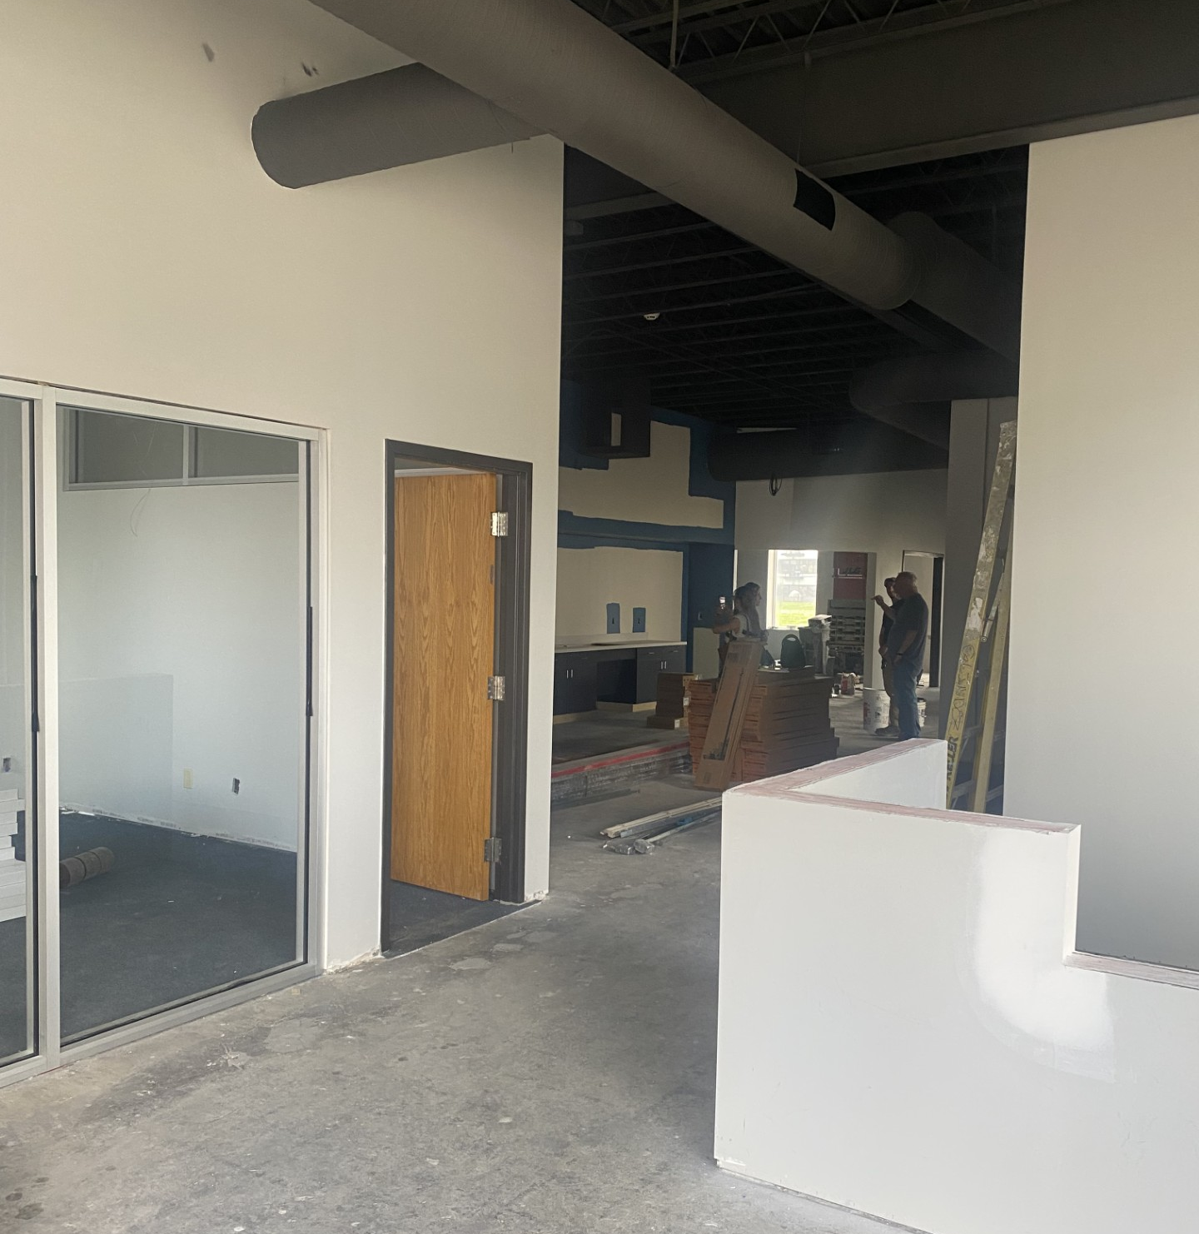
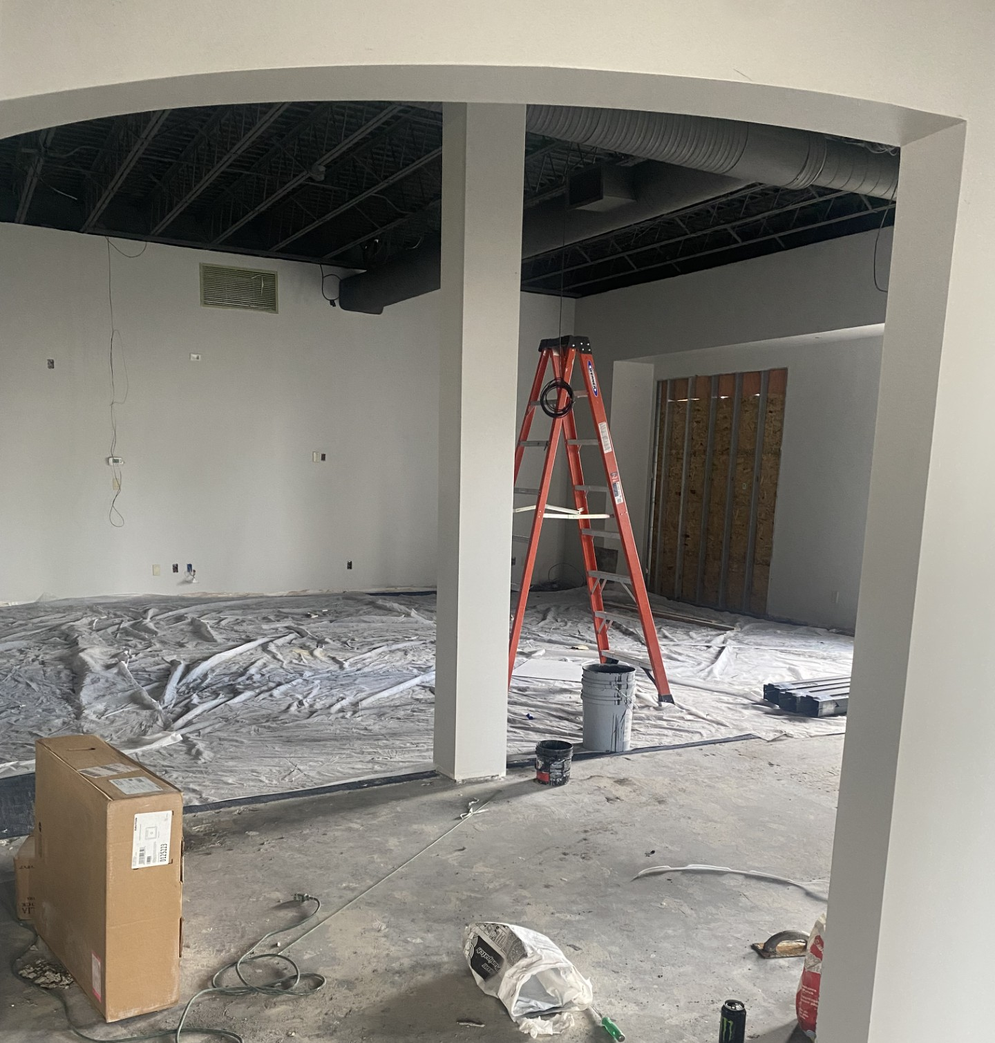
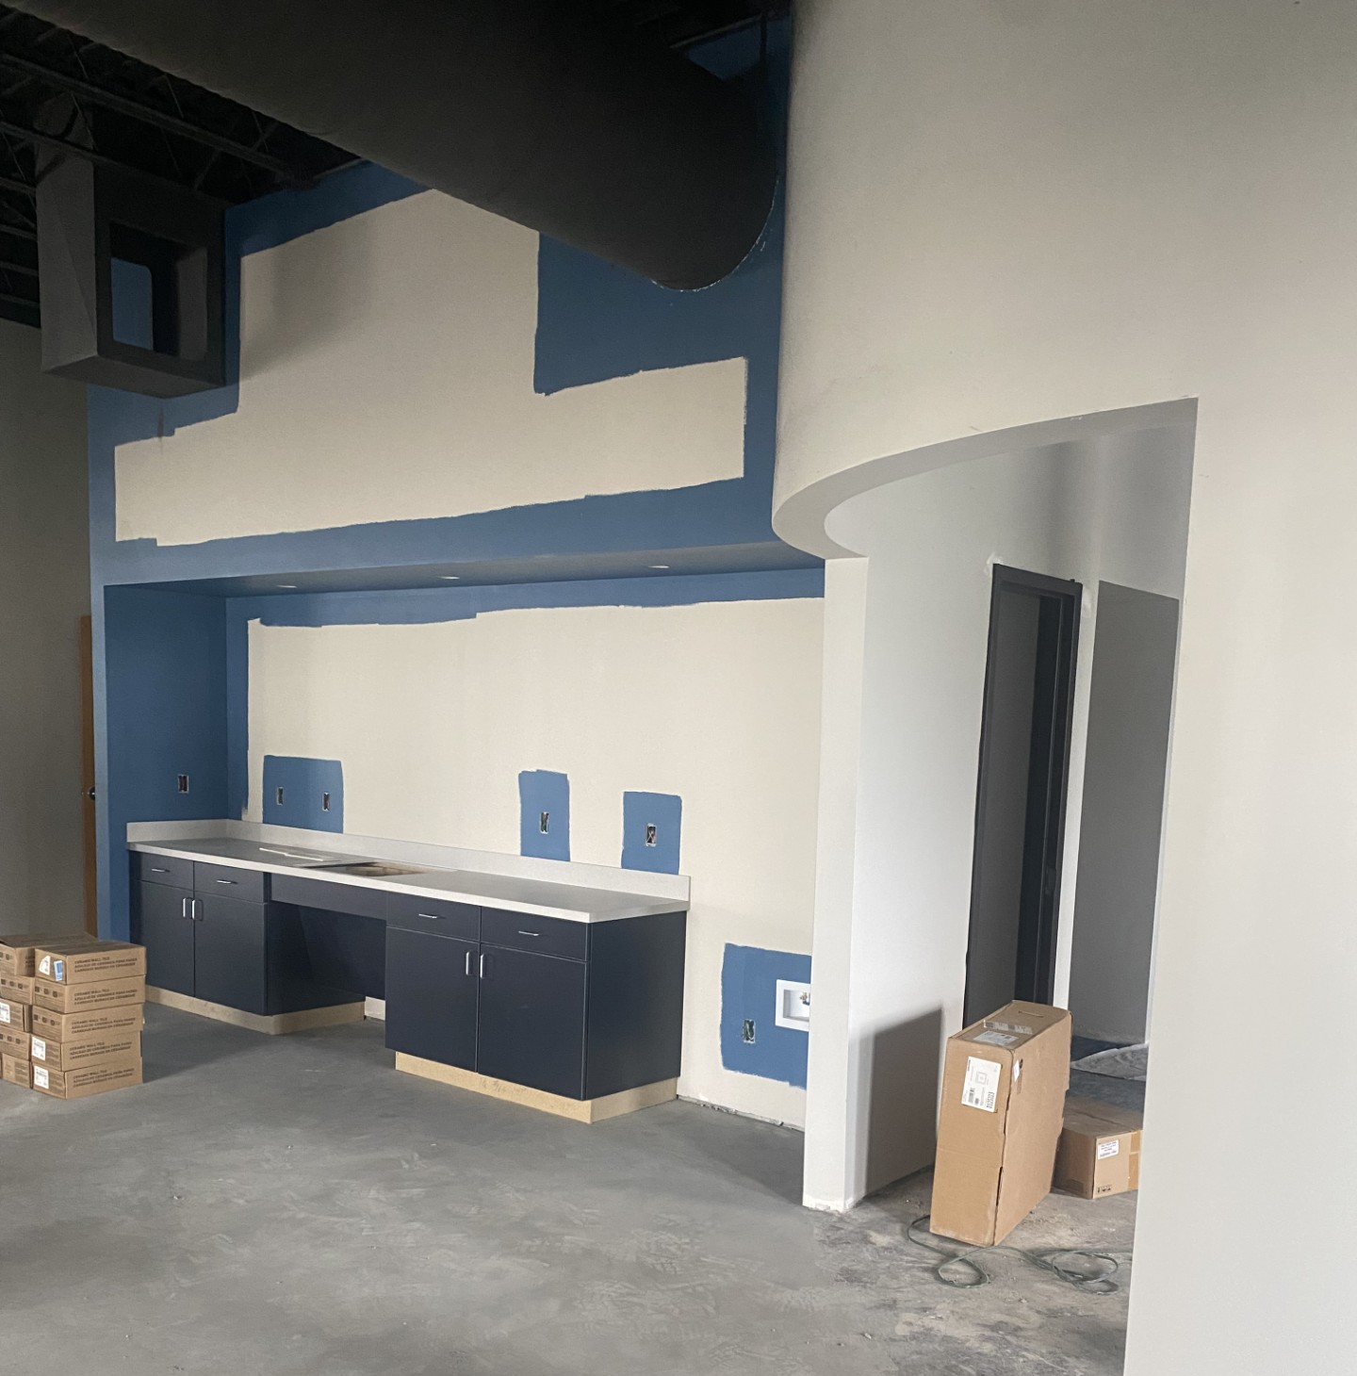
Renovation is on track

Slide 5
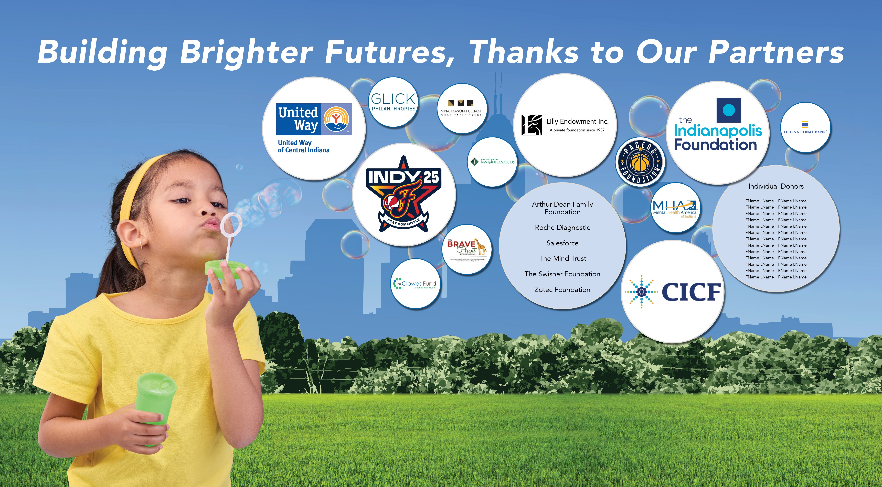
Draft: Donor wall

Slide 6

Where the children are
Published! (handout – also available via download from website)
Early Intervention Planning Council – MCCOY
Conducting series of community conversations, presenting to relevant groups
Mailed print copy to leaders across the City as well as key community leaders
Next Steps – planning session for next steps

Slide 7
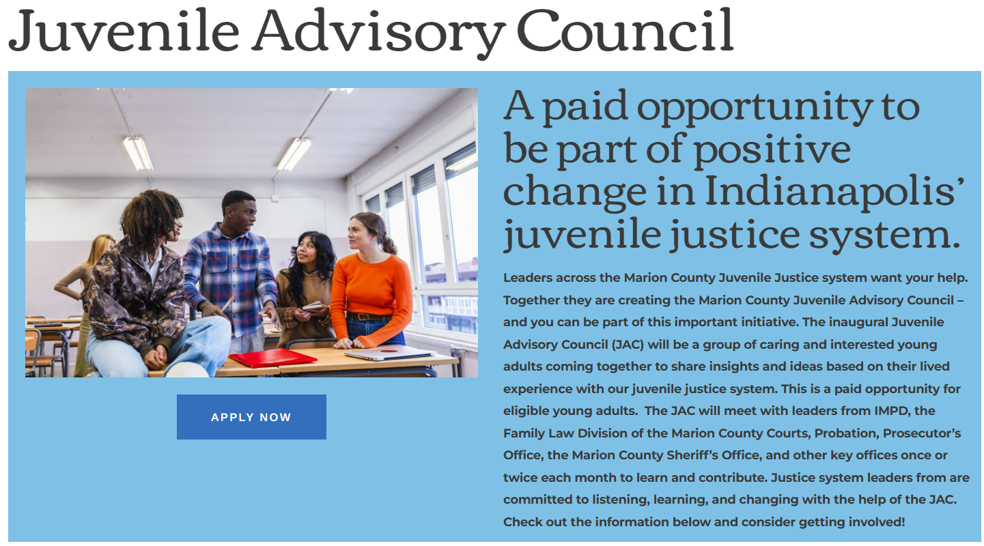
Launched!

Slide 8
Summer youth program – youth working for indy
Reminder – declined $37,500 Community Development Block Grant through the City
--total grants from others: $120,000
Awarded 25 grants, totalling ~$124,000, down from $137,000 in 2024
MCCOY will cover ~$4,000 in grant funds, and $15,000 in overhead not covered by grants

Slide 9

What questions or concerns do you have?

