Slide 1

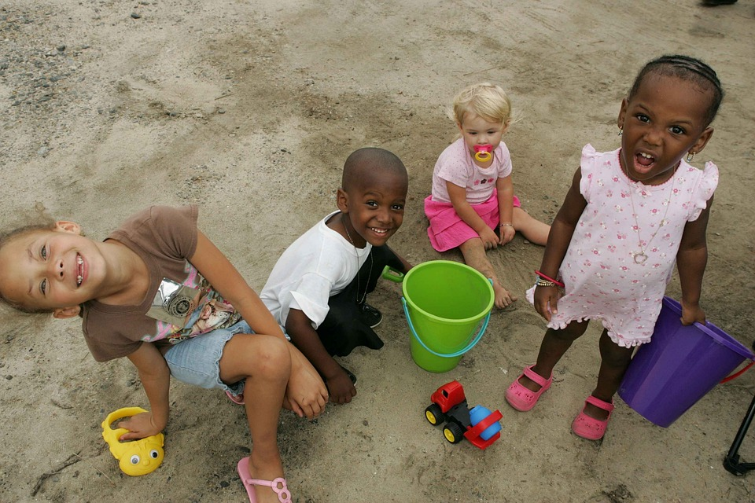
Board of Directors Meeting
June 26, 2024
-----------
Updates from Liz

Slide 2
Items to address..
6- Month
Updates
Strategic Planning Process
Paid time off (PTO) proposal

Slide 3

First 6 months – PLAN
Organization level:
  Payroll and benefits transition almost complete
  Annual Report
  Fundraising plan in process – focus on unrestricted funding
  Staff role review and focus ...

Slide 4
First 6 Months: Plan
Evaluate need for organizational change –
    Refocusing to prioritize PROGRAM work
      Eliminating the "strategy & ops" role that wasn't adding value
    Reframing administrative support to focus on Event Coordination, support for fundraising, overall operational oversight
Liz - ED
Open – Admin/Events/Fundraising support
Hannah – Mkting & Communications
Sarah - Advocacy
Fletcher – Capacity &
Workforce Devel
Levi -- Evaluation & Metrics (PT)
Kate – Early Intervention (0-8th grade)
LaMarr - Youth Voice & Engagement (HS)
Becca - MCYVPC

Slide 5

First 6 Months – PLAN
Programming – taking a more systemic view for greater impact:
  Advocacy
  EIPC
  Closing the Gap
  MYLC
  Summer Youth Program!!
  Capacity development

Slide 6
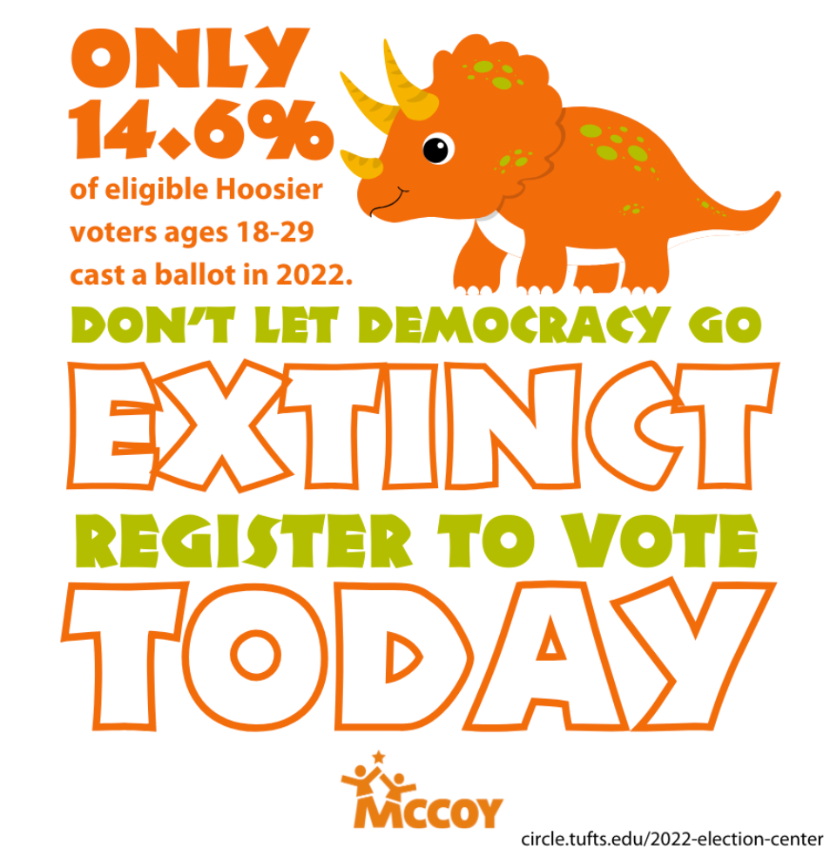
Advocacy
Training - fee-based @ $500/day
Voter Registration campaign – direct and indirect push

Slide 7
Closing the Gap and EIPC
Closing the Gap
Subgrants selected by early August ($100k total; 5-10 grants)
September 12 Symposium at Landmark Center
Innovation Workshops x 3 (problem solving focus)
Grant term ends December 2024 – we will not “renew”
EIPC
Creating a "where are the children" data book
documenting displaced youth
understand why and focus efforts on how to reduce those numbers

Slide 8
MYLC
Impact Team
Funding secured for next 2 cohorts (through mid-2026)
August 3 Orientation at Eagle Creek Park
New cohort selected – 28 youth/24 schools
New grant will support 2 interns for the program
Alumni intern
Intern from Mayor’s office

Slide 9
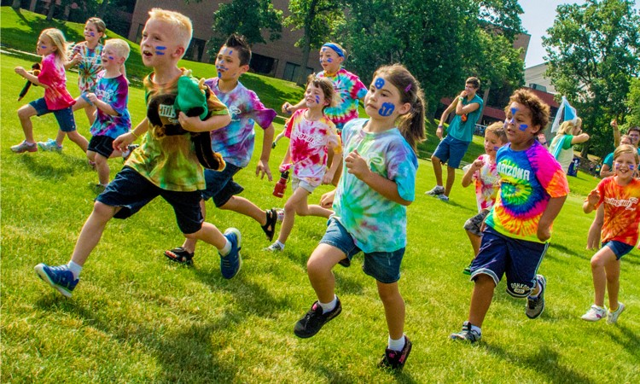
Connect
Summer Youth Program
Listen
Inform
Celebrate
Develop Capacity

Slide 10
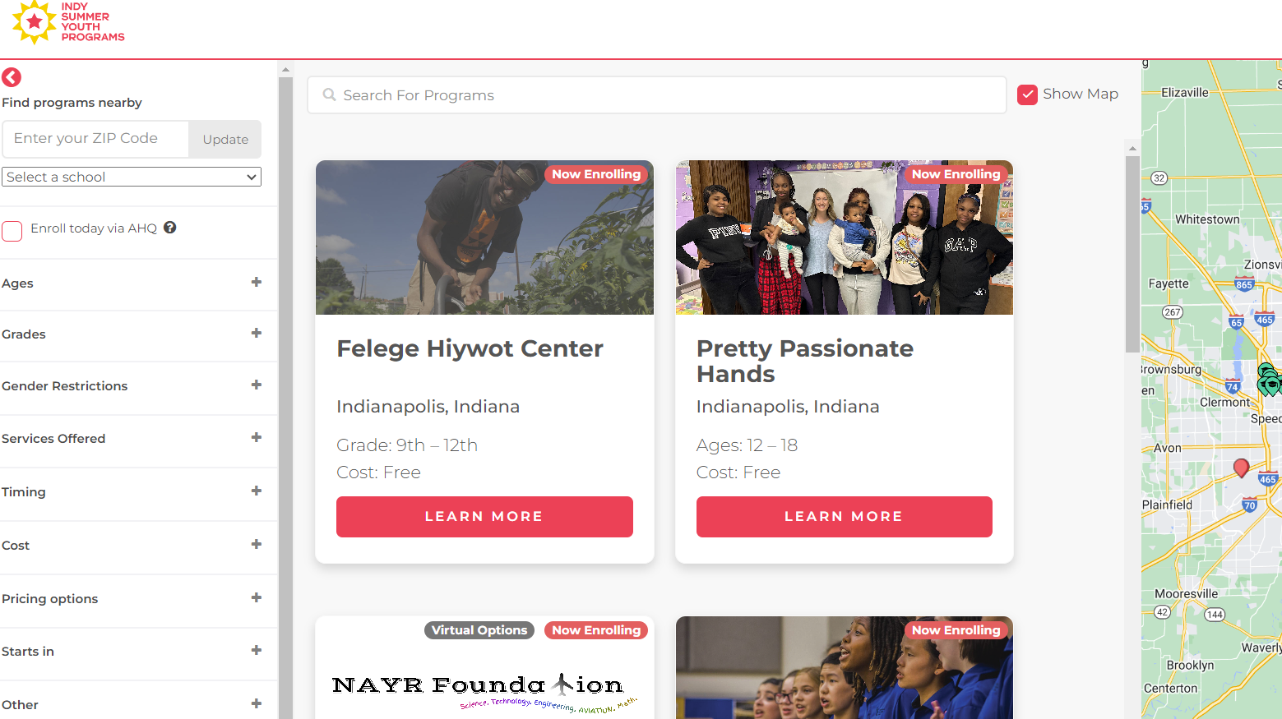
Raising Awareness
Connect
Online Directory of SYPF opportunities
Via AfterSchool HQ website: indysummeryouthprograms.org
Searchable by type, location, age range, cost
Local advertising to families/caregivers of youth – ages 5-16
Borshoff Advertising Agency
March 4 – June 11
Focused on zip codes with historical draw for SYPF
Estimated reach: 6.6 million impressions/17,000 clicks reaching 85% of the target audience an average of 80x daily through the “flight”
Media: google search, outdoor ads (billboards/benches), Facebook paid ads

Slide 11



Slide 12
Building Community
Connect
Agency Executives monthly meeting with Liz
Sharing best practices
Learning about resources
Sharing news and opportunities
Giving us feedback
SYP Check Ins with Fletcher
Focused on technical support and logistics
Monthly meetings:
April 10, In person gathering at IAN conference – 35 organizations
May 15 virtual call – 20 organizations
Upcoming check ins: June 20, July 17, August 21

Slide 13
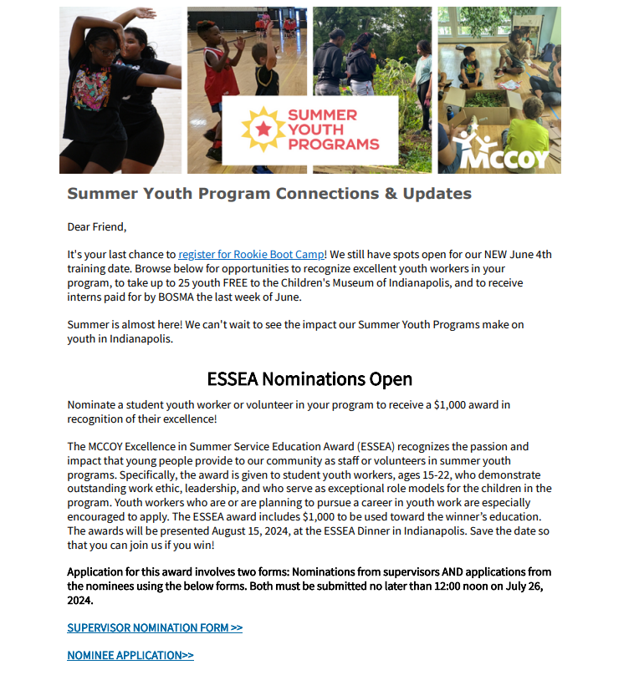
Frequent, formal and informal communication
We have sent SIX newsletters to SYP grantees so far since the grant announcement. See below for open and click rates:
Inform
SYP Connections & Updates Newsletter
  Consolidated communications (vs. scattered emails from various people in past years)
  Distributed 2x/month
  232 SYP organizations are receiving the newsletter
    Program Director and others as identified
    Can we add camp director name and email address to the SYPF application (currently the grant writer who may not be involved in programming)
  Open rates are between 55-70% with a click through rate of 15-100% (depending on the content)
Creating personal relationships through check ins and agency executive calls for individual support as well
If you’d like to be added to the distribution, please let me know

Slide 14
Strengthening Programs
Develop Capacity
Youth Working for Indy
Addressing 2 challenges:
Shortage of workers to support summer programming
Shortage of summer employment opportunities for underserved and/or marginalized youth (16-22) in our community
MCCOY is funded through SYPF to provide wage support for these youth
34 SYPF organizations received ~$140,000 funding in 2024
Supporting ~90-110 youth workers
Youth Program Quality Assessments
Voluntary participation
Organizational and program assessments using Weikart tool
6-8 organizations will participate in 2024
Each assessment takes a week to complete, plus report and debrief

Slide 15
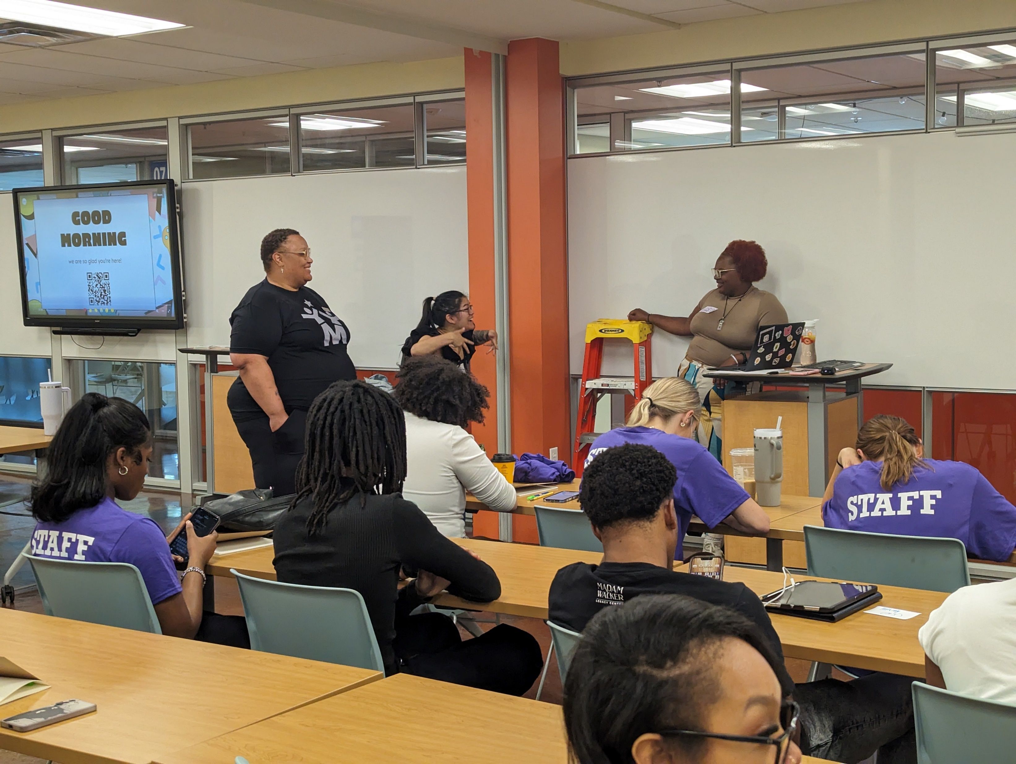
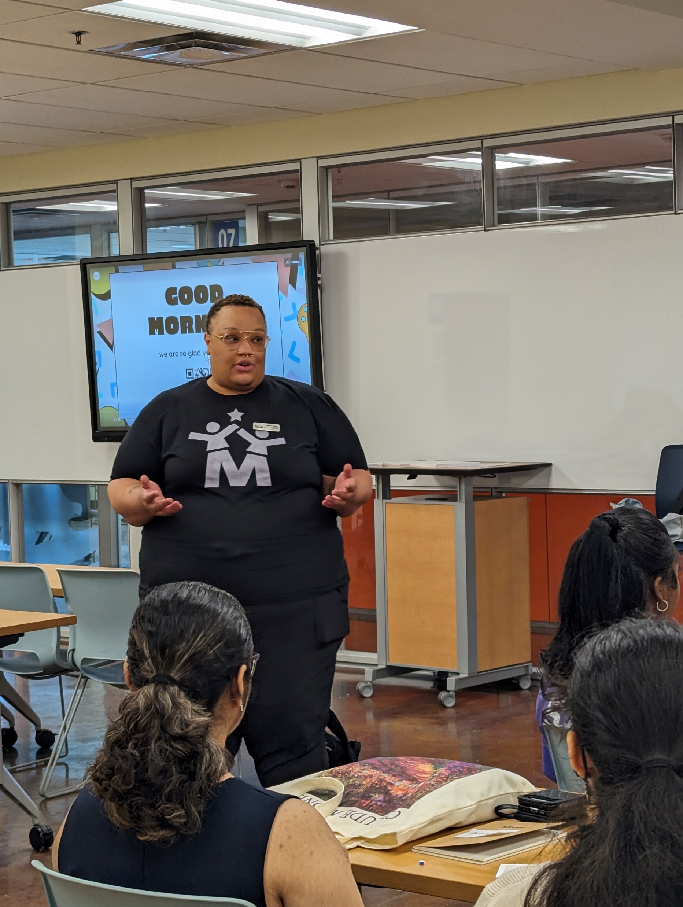
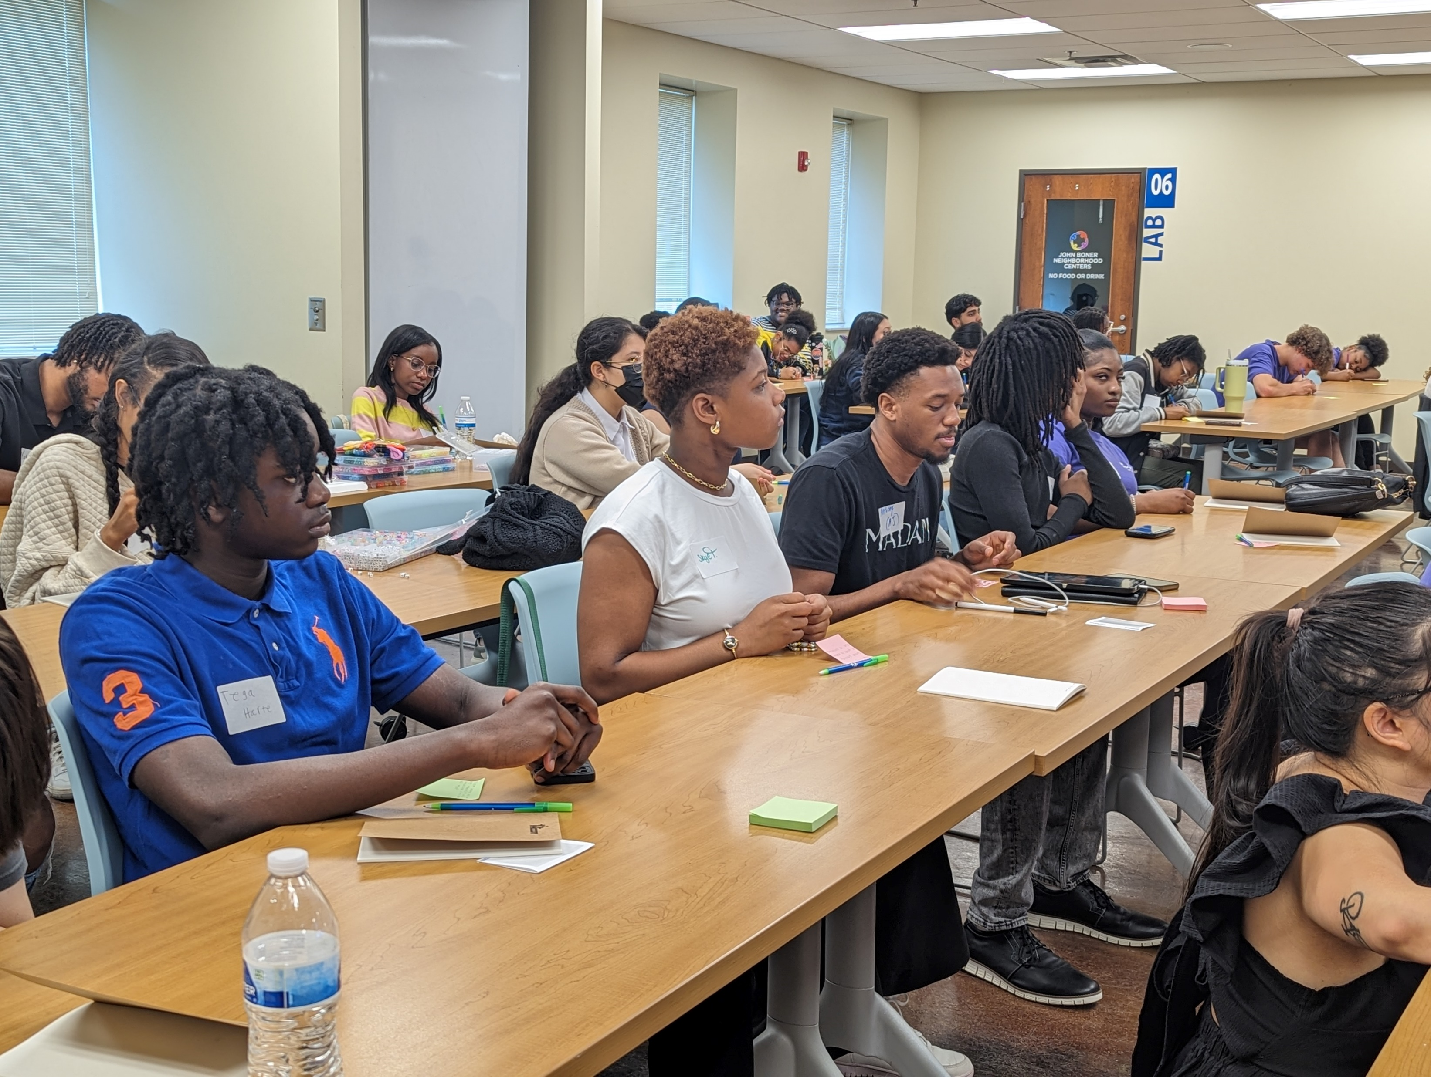
Increasing capacity
Develop Capacity
Rookie Boot Camps
  Full day in person workshops held at John Bonner Center, May 30, June 4, June 6
    and June 11 (virtual)
  Returned to in person format based on feedback from 2023 participants
  162 participants across 3 in person sessions, plus 45 registered for the virtual session (June 11)
    Mandatory for all YW for Indy recipients
    Plus, any other first-time employees
CPR Training
Access to full menu of MCCOY trainings at no cost for SYPF orgs, including
  DEIB
  Trauma-informed care

Slide 16
Celebrating Youth!
Celebrate
Summer Learning Day
  Free field trip opportunity for SYP camps
  440 SYP campers and their adult chaperones (~80)
  Wednesday, June 26 @ The Children’s Museum
    Butler Men’s basketball team! (NIL All Good Dawgs)
Excellence in Summer Service Education Awards (ESSEA)
  Nomination/Application process to recognize outstanding summer youth workers
  25 awardees and all nominees will be recognized this year
  Celebration will be August 15 at the Dolphin Gallery at the Indianapolis Zoo

Slide 17
What Else Do They Need?
Listen
Top priorities for SYPs as they look ahead
Continuation of training for staff
Certification?
Mentoring and developing plans post high school
Professional development for staff
Staff retention/mental wellness
Greatest challenges faced by their programs
Training staff (55%)
Training leaders (55%)
Recruiting staff (45%)
Grant writing/fundraising (45%)
What training opportunities are you interested in for your staff?
Social/emotional learning (83%)
Violence response/de-escalation (78%)
Difficult conversations with youth (58%)
Trauma-informed care (58%)
Mental health first aid or emotional CPR (42%)
Time fillers and attention getters (75%)
What training opportunities are you interested in for yourself or other leaders on your staff?
Leadership styles (Compass points) (92%)
Continuing education/professional development – scholarships to support it (83%)
How to find community resources for families/youth in their programs (67%)
Difficult conversations with youth (58%)
What other ways can we support the success of your SYP? (write in)
Any training!
Resources/training for parents on safe and fun summer activities for their children
Identifying no cost/low-cost field trips
“Anything that makes us better”

Slide 18
Capacity Development
SYP
Emerging Leaders of Color -- Youth Worker Well-Being Project
  Serving as 1 of 4 instructors (fee for service contract basis)
  4 cohorts over next 24 months
T.R.A.P. pilot program
  Collaboration with Glick Philanthropies/Glick Properties
  Developing curriculum, piloting program, developing train-the-trainer program, creating evaluation tools and protocols
  MOU is being developed

Slide 19
Time off – current vs. Proposed
revisiting from our April discussion

Slide 20
  Current
  15 Vacation days/year – 5 days carry over to 1Q (unused accrued in that year are paid out at separation); accrue 1.25/month
  6 Personal days (no carry over; not paid out at separation)
  6 Sick days – can accrue up to 30 days with no expiration (not paid out at separation); 0.5 days/month
  Office closed between December 25 and January 1
  9 Holidays
Challenge: Sick time is not valued by majority of staff - rarely used. Its value is as an accrued benefit towards STD
Proposed – implement January 1, 2025
  WHY? With addition of ST and LT Disability policy need for accrual of sick time is mitigated; all employees benefit more evenly with PTO policy
  24 PTO days/year -- accrues 2.0 days/month on first day of the month; carry over 5 days into the first quarter of subsequent year
  Office closed between December 25 and January 1
  9 Holidays
  Payout at termination limited to accrued unused PTO in that year
  Cost to MCCOY – one time cost to buy out accrued sick leave in January 2025
  Challenge to MCCOY – we will see more time off – but s/b positive for employees

Slide 21
Strategic Priorities |
Strategic Planning Process

Slide 22


Our mission is to champion the positive development of youth through community and systems change
Support quality and growth for youth-serving organizations across Marion County
Inform and support the system to create a safe environment where our youth thrive and develop
Strategic priorities -- what rises to the top preventing this from happening?​
Mental Health
(youth and youth services workers)
Youth Violence Reduction and Prevention
Youth Services Worker Pipeline

Slide 23
First 6 Months: Plan
With those priorities in mind, what are the strategy questions to be addressed?
  Define the needs and role for MCCOY - what is being done? What needs to be done? Where and how is MCCOY most effective in addressing those needs not yet being effectively address?
  How do we need to reframe our programs/projects and our organizational focus to address the needs?
  How do we connect our work across the organization for greater impact?
    E.g., Youth Violence Reduction: what role do each of our program areas need play (Awareness (marketing/PR)/capacity and training/advocacy/early intervention/youth voice)
Process and timeline
  Internal work tapping into external sources to address the strategic priorities seperately but simultaneously
  Drafting strategic overview of the issue, approaches and needs document
  Pre-discussions with potential funders (UWCI, CICF are the current priority)
Goal is to have documented strategic "plan" by end of 3rd quarter with funding plan in place

