Slide 1
WELCOME TO THE BOARD!
MCCOY on-boarding PACKET

Slide 2
Table of Contents
01 Mission, Vision, and History
02 Finances
03 Meet the Staff
04 Board Member 101
05 Expectations
06 Personalization

Slide 3
MISSION
MCCOY champions the positive development of youth through leadership on key issues and support of the youth worker community.
connect kids with programs
[ ]
VISION
Every young person in Central Indiana has opportunities to thrive, learn, engage, and contribute.
reach as many kids as possible
[ ]
01 Mission, Vision, and History

Slide 4
STRATEGIC OBJECTIVES
Find more detail about objectives and goals outlined here
01 Continue as leader for youth and youth services by serving as resource, convener, advocate, and capacity builder
02 Enhance and expand MCCOY’s ability and capacity to communicate the story of its work and impact to partners and general public
03 Develop MCCOY’s capacity to better document, evaluate, and report our impacts and outcomes
04 Assess current and historical funding sources and opportunities to develop/implement efforts to grow new revenue sources
05 Simultaneously explore opportunities to develop leadership skills of current staff and board while identifying where additional staff and board resources are needed to grow MCCOY’s work
06 Engage a trusted group of parters to position MCCOY as THE recognizable community leader for youth and youth issues
01 Mission, Vision, and History

Slide 5
EXPLAINING WHAT MCCOY DOES
ADVOCATE
Unifies individuals and organizations to promote the participation of youth in public policy and in decision-making circles
CAPACITY-BUILDER
Provides tools and trainings for youth-serving professionals and youth workers to build skills to effectively serve youth around them
CONVENER
Gathers passionate community members in partnership to build solutions for youth to thrive, learn, engage, and contribute
RESOURCE
In user-friendly formats, MCCOY connects youth and their families to the programs they need to achieve their dreams. MCCOY also connects professionals to the information they need to serve youth more effectively
01 Mission, Vision, and History

Slide 6
EXAMPLES OF PROGRAM TYPES SUPPORTED BY MCCOY
Family Fun
Family Support
Leadership/Volunteer
Life Skills
Mentoring
School Year
Special Needs
Summer Jobs
Suicide Prevention
01 Mission, Vision, and History

Slide 7
HISTORY
1987 Established as part of city-county government
1993 John Brandon hired as first executive director
1994 MCCOY becomes independent 501(c)(3) non-profit
1996 Hired Program Associate and Admin Assistant
1997 First Youth Activity Directory published
1998 Certified as United Way agency
1998 Hired Planning/Research Associate
2000 Hired Director of Advocacy and Public Policy
2001 First active participation in state legislature
2005 Hired Community Initiative Coordinator and Marketing and Development professional
2006 First significant Lilly Endowment contribution
2009 Hired Community Coordinator and Resource Development Officer
2015 Relocated headquarters to current location
2016 Studied and validated current strategic focus
Click here for a detailed history
01 Mission, Vision, and History

Slide 8
BUDGETS
2017 $1,465,042
2016 $1,451,260
NON-PROFIT ACCOUNTING CHEAT SHEET
Non-profit financial statements differ from the for-profit world. The following provides basic information to get you started.
02 Finances

Slide 9
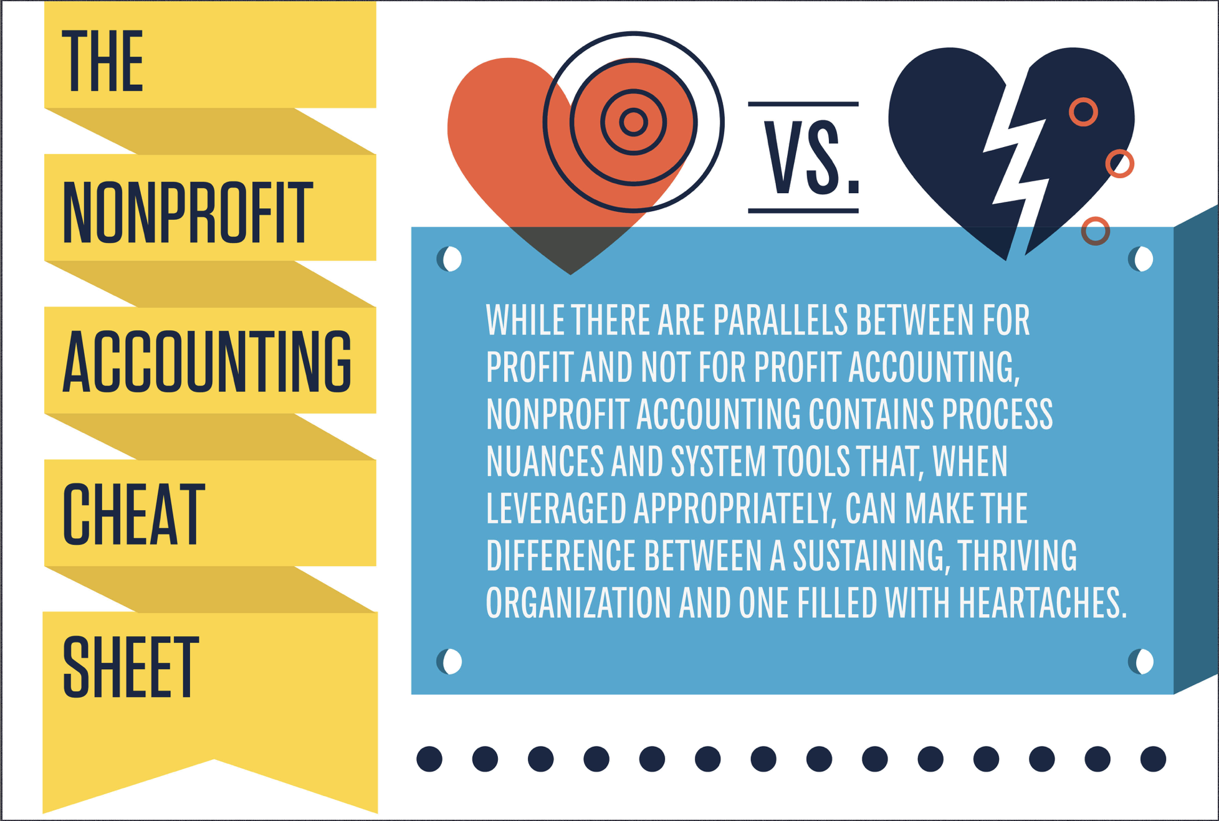
02 Finances
borrowed from https://npengage.com/nonprofit-management/fund-accounting-cheat-sheet/

Slide 10
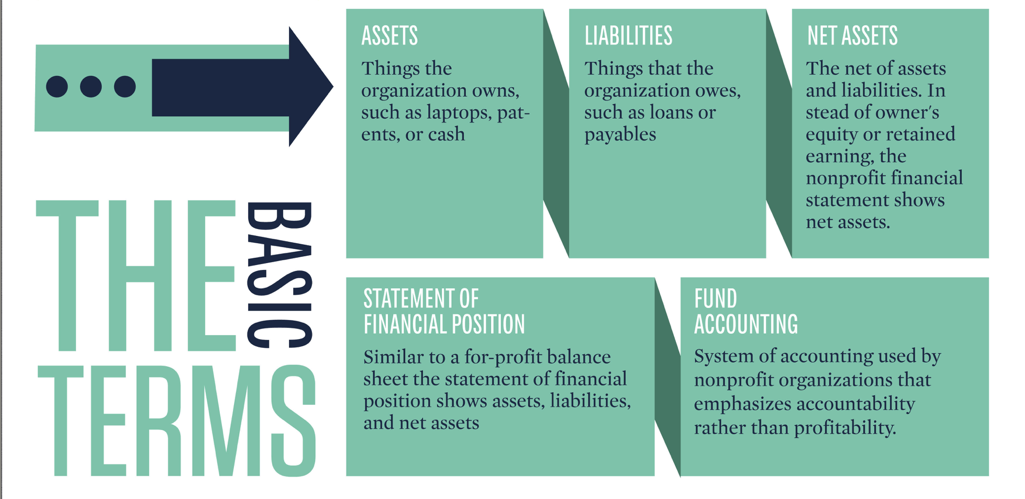
02 Finances

Slide 11
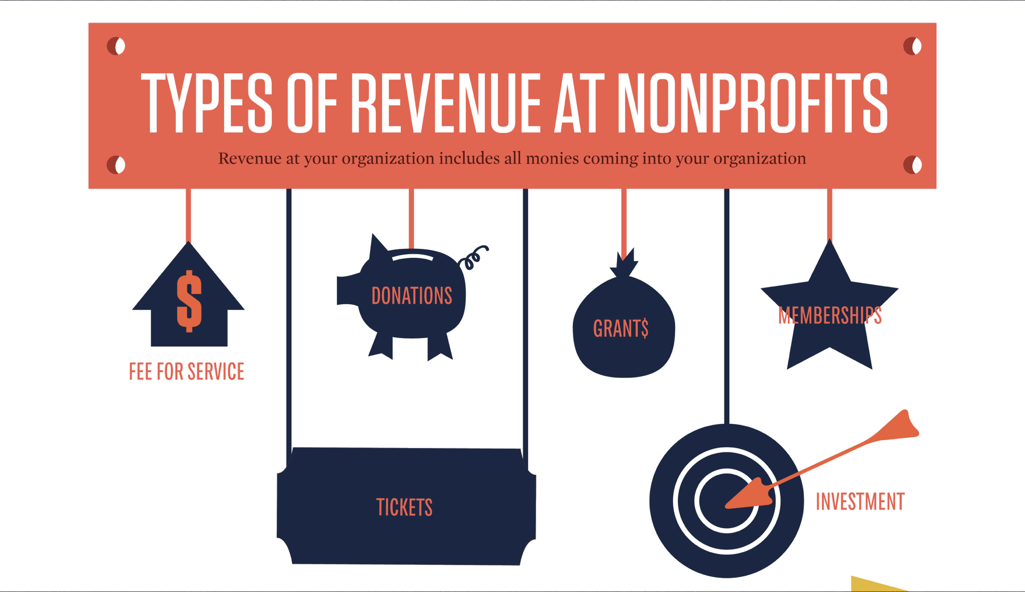
02 Finances

Slide 12
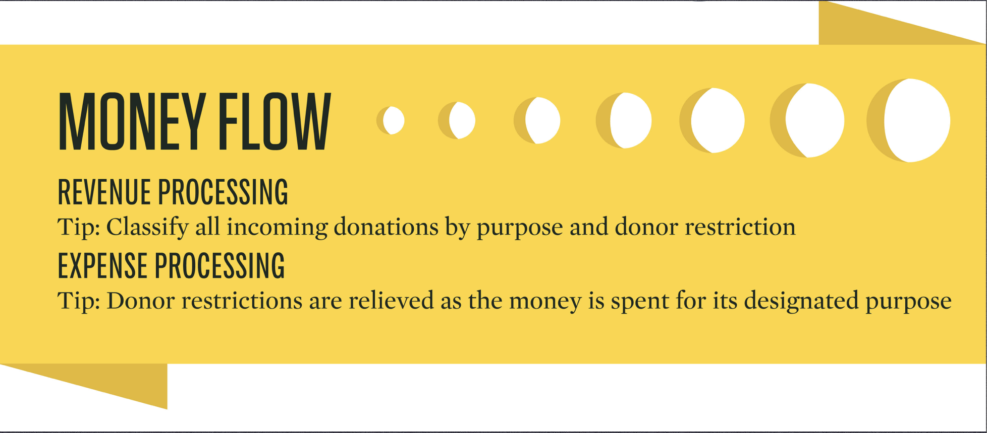
02 Finances

Slide 13
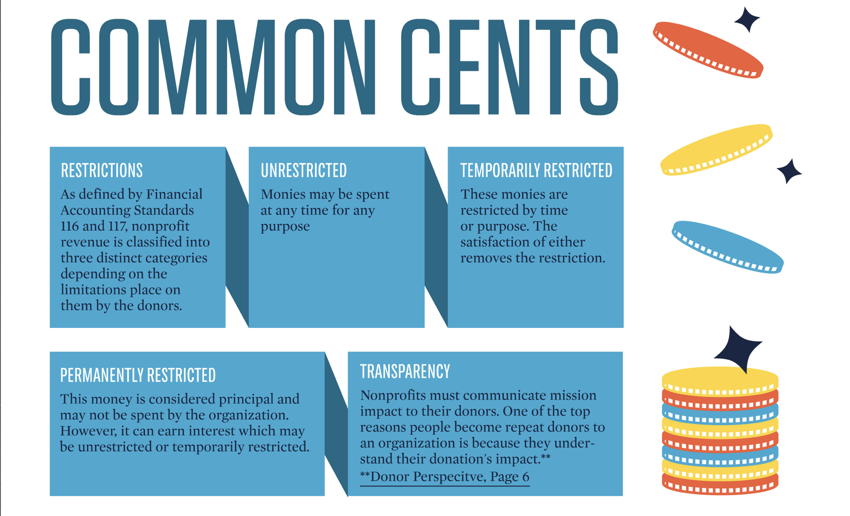
02 Finances

Slide 14
02 Finances

Slide 15
02 Finances

Slide 16
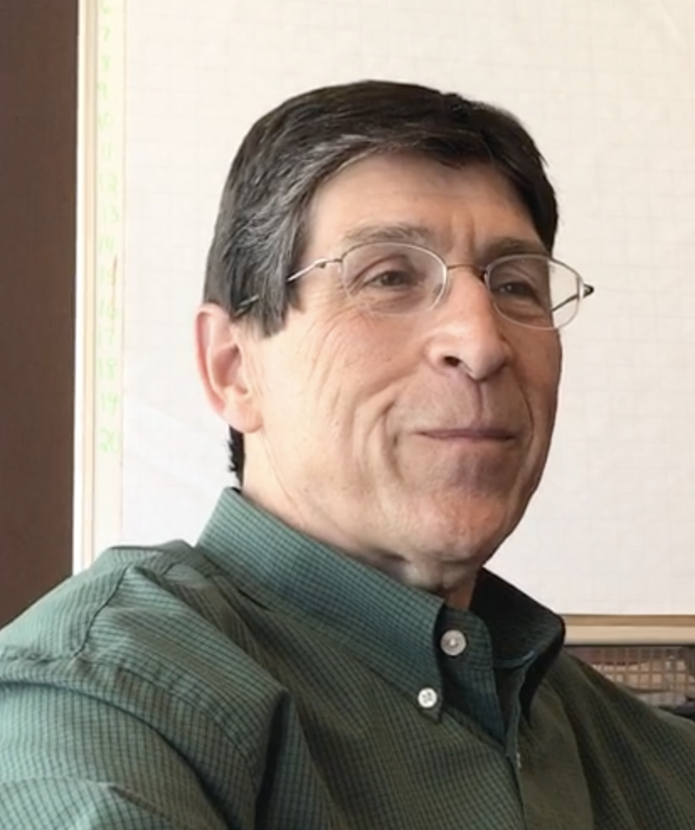
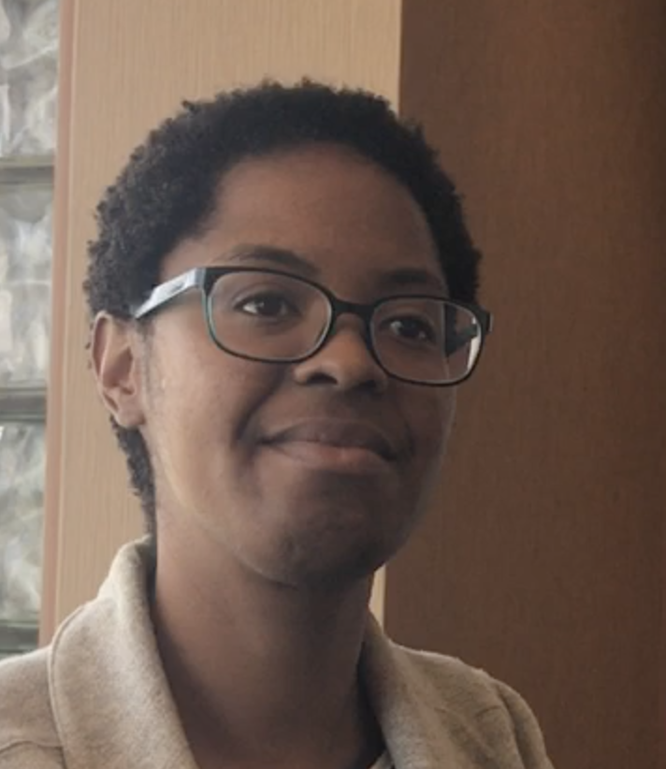
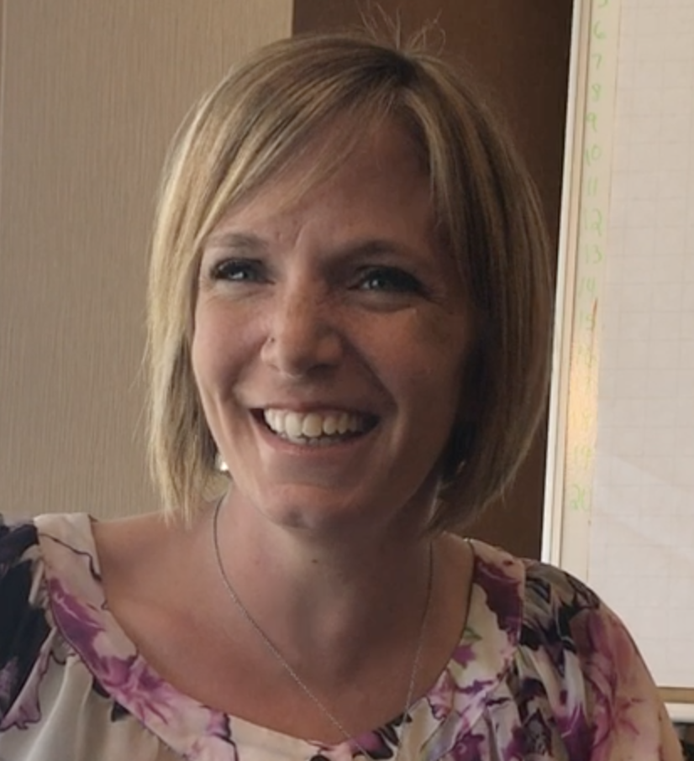



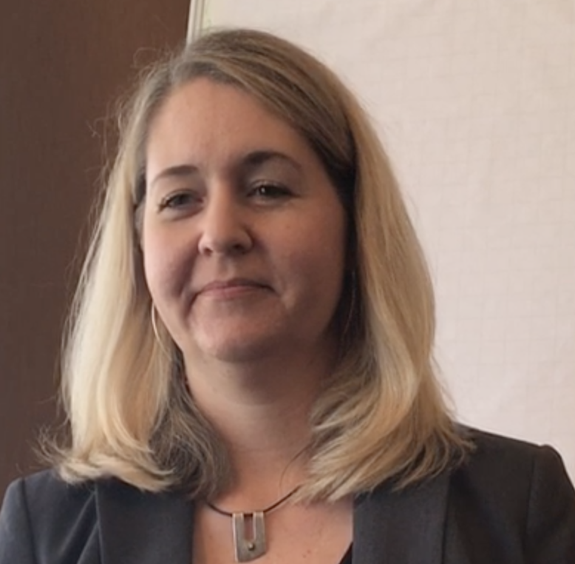
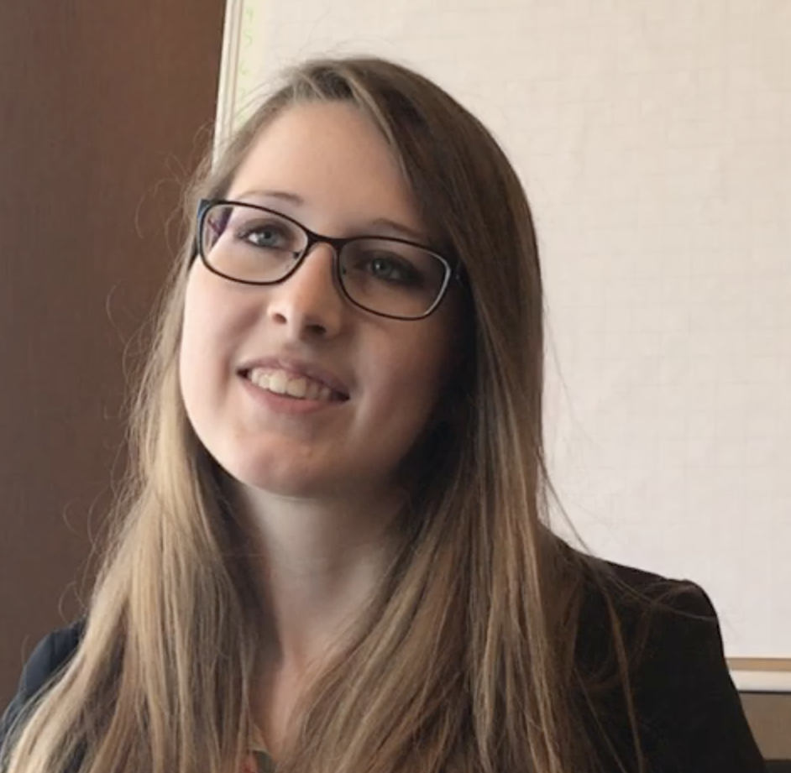
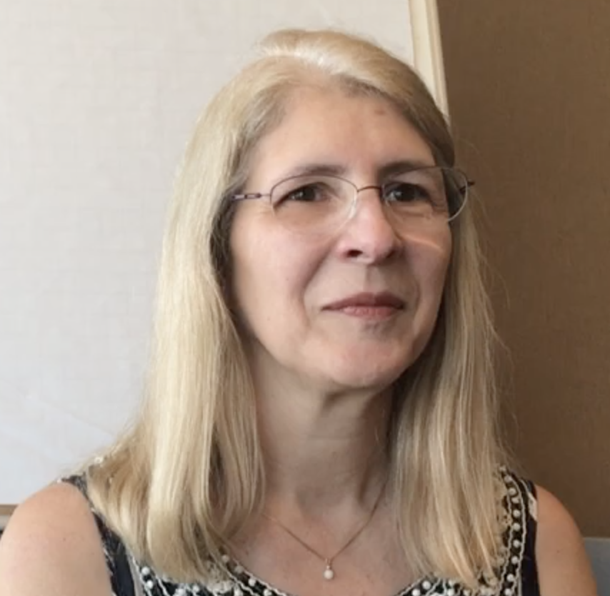

John Brandon
Mitzi Wilson
Becky Reich
Mindi Goodpaster
Jacie Farris
Juli Van Wyk
03 Meet the staff

Slide 17
John Brandon
President & Executive Director
Mitzi Wilson
Early Intervention & Prevention
Initiative Director
Becky Reich
Training Director
Mindi Goodpaster
Public Policy & Advocacy Director
Jacie Farris
Communications Director
Juli Van Wyk
Staff Assistant
Click here for a video featuring staff explaining their roles
03 Meet the staff

Slide 18
LEGAL OBLIGATIONS
-Exercise prudence in the control oversight and transfer of the organization’s funds
-Read and understand the organization’s financial statements and help the board fulfill its fiduciary responsibilities
-Exercise independent judgment
AVOID conflicts of interest
BOARD INSURANCE is provided by MCCOY
MEETING FORMAT follows Robert’s Rules of Order
-A consent agenda allows members to agree on the previous meeting minutes so that meeting time is not used to revisit old information
Click here
04 Board Member 101

Slide 19
ENGAGE as a board member and attend 80% of meetings
JOIN a committee
SUPPORT and donate
-annual personal donation
-attempt to raise funds
ADVOCATE
Public Policy & Advocacy
Marketing & Communications
Fund Development
Finance
Governance & Board Development
Programs
Click here to review the full set of published expectations
05 Expectations

Slide 20
RESOURCES
Included with this packet should be a copy of the bylaws.
These as well as all important board documents are posted on the board portal
Click here to visit the board portal
A PERSONAL INTRODUCTION
Each board member should be paired with a current board member to give a tour of the building and staff introductions.
06 PERSONALIZATION

